Slide 1
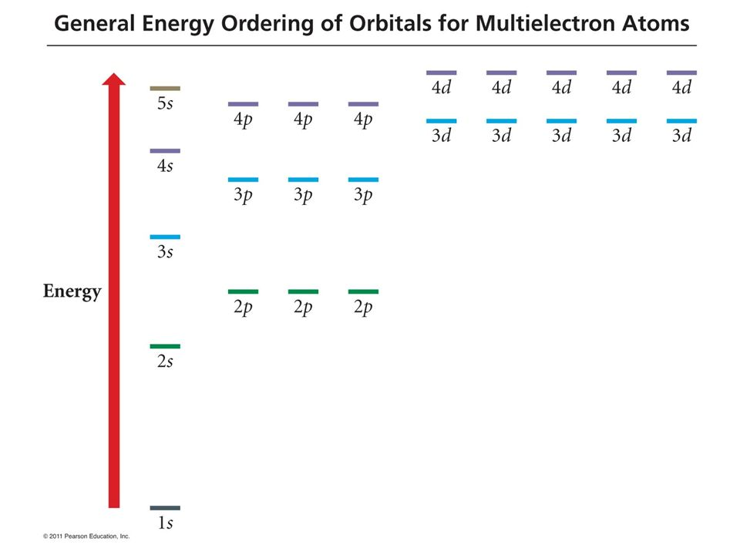
Zinc
Spartan bunches these up just below the orbital labeled HOMO
Spartan labels this “HOMO”
Spartan doesn’t even display these (core) orbitals
For Zinc, our general energy ordering got it wrong … can you tell how?

